Slide 1
Advanced Technology Lab

Slide 2
Project
Paper
Communication

Slide 3
Advanced technologies
Artificial Intelligence
Blockchain
Augmented Reality and Virtual Reality
Cognitive Cloud Computing
Angular and React
Internet of Things (IoT)
Intelligent Apps (I – Apps)
Big Data
RPA (Robotic Process Automation)
Image/Video Processing
Speech Recognition
4G/5G Networks
Ubiquitous Computing
Web 2.0/3.0

Slide 4
Artificial intelligence
Artificial intelligence (AI) is the simulation of human intelligence processes by machines, especially computer systems.
Artificial intelligence is a branch of computer science that aims to create intelligent machines. It has become an essential part of the technology industry.

Slide 5
Artificial intelligence
The core problems of artificial intelligence include programming computers for certain traits such as:
Knowledge
Reasoning
Problem solving
Perception
Learning
Planning
Ability to manipulate and move objects

Slide 6
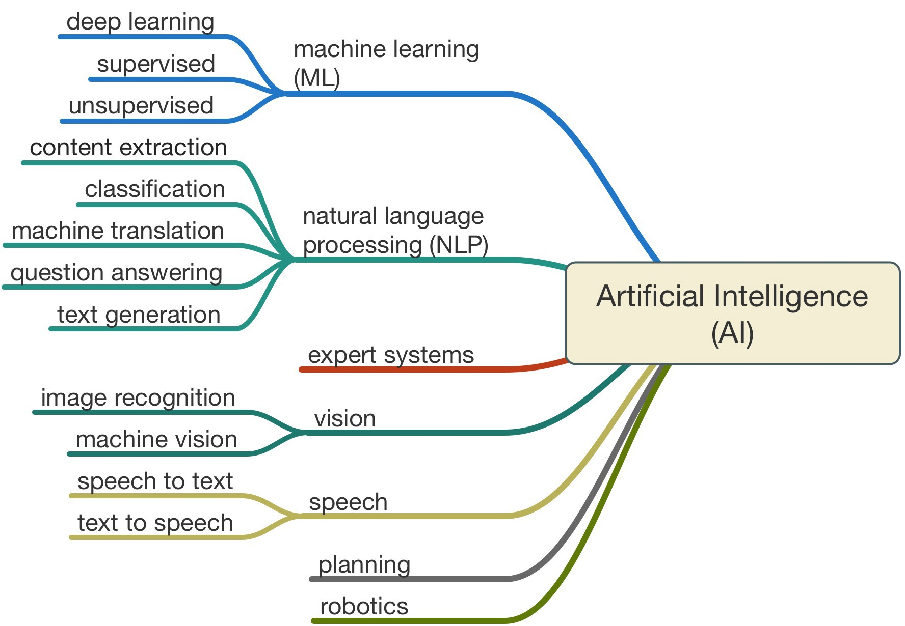

Slide 7
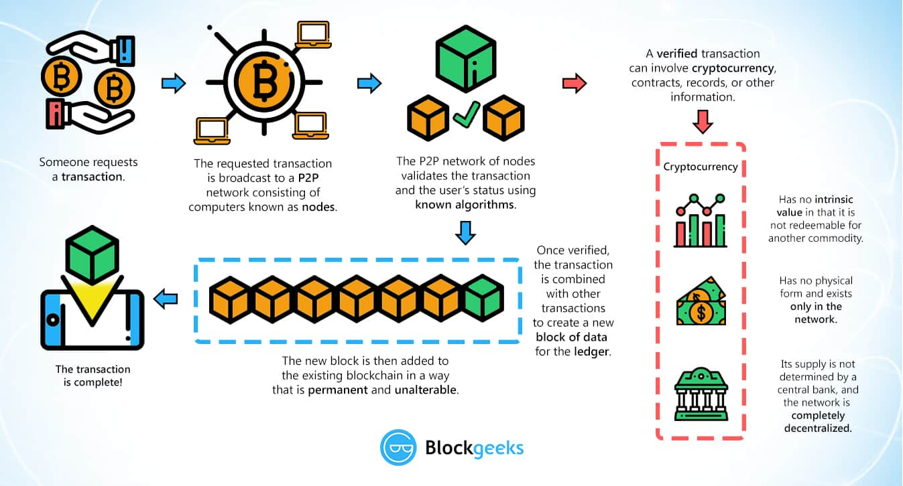
Blockchain
Blockchain-Based Voting System

Slide 8
Robotic process automation
Robotic process automation (RPA) is the application of technology that allows employees in a company to configure computer software or a “robot” to capture and interpret existing applications for processing a transaction, manipulating data, triggering responses and communicating with other digital systems.
The Process of automating the workflows with the help of robots/software to reduce the involvement of humans is said to be Robotic Process Automation.
Examples: Problem Statement: Task is to scrape the number of GitHub repositories for the top technologies in today’s market.
https://www.edureka.co/blog/rpa-projects

Slide 9
Sl.No | Date | Plan | Marks
1 | 3/1/2020 | Introduction to the lab
2 | 10/1/2020 | Proposal document | 5
3 | 17/1/2020 | Literature Survey | 5
4 | 24/1/2020 | Methodology | 10
5 | 31/1/2020 | Work on project
6 | 7/2/2020 | Progress evaluation | 10
 | 14/2/2020 | I test
7 | 21/2/2020 | Work on project
8 | 28/2/2020 | Progress evaluation | 10
 | 6/3/2020 | Revels
9 | 13/3/2020 | Experimentation details and result analysis | 10
 | 20/3/2020 | II Test
10 | 27/3/2020 | Full paper submission and communicating it to conference or journal | 10
11 | 3/4/2020 | Completion of the project
12 | 9/4/2020 | Demonstration of the Project | Final Exam (40)

Slide 10
Proposal Document
Project Overview
Problem Definition
Scope
Objectives
Generic project life cycle for the chosen technology

Slide 11
Literature Review
10-15 papers [Scopus journals]
Research Gaps
Finalized objectives

Slide 12
Methodology
Architecture diagram and explaination
Process flow and explaination
Objective-wise methodology and explanation

Slide 13
Experimentation details and result analysis
Software used
Data used
Algorithms/Flowcharts
Time complexity analysis
Results -> Graphs, tables and analysis

